Slide 1
Electromagnetic Radiation 9 – Human Vision

Slide 2
1. Black-and-White Vision and Colour Vision
  a. The cells in your retina that absorb light come in two basic shapes: longer cylindrical ones called rod cells and rounder ones called cone cells
  b. Rod cells can absorb almost any colour of light, but they absorb green light particularly well.
    i. Our brain does not use any of the signals from rod cells to determine colour—just shades of light and dark.
    ii. This is called our black-and-white vision system
      In low-light conditions it helps us see shapes and movement.

Slide 3
  c. Cone cells allow us to detect colour.
    i. We have three kinds of cone cells, each with a slightly different kind of pigment.
      Remember that seeing red, green, and blue it is possible to see all the colours of the rainbow.
    ii. If our brain receives an equal amount of all three colours, then we see the object as white.
      Our brain can combine and balance the different colour signals that it receives.
      So the white page of a book will always appear white to us under varying amounts of daylight.

Slide 4
2. Most people have trouble focussing clearly at some time in their lives.
  a. As we grow, especially in the teen years, the shape of the eye changes.
    i. The change of shape can affect the ability to focus and may require the temporary use of eyeglasses.
  b. As adults age, the flexibility of the eyes’ lenses often decreases, making it harder to focus on nearby objects.

Slide 5
3. Normal vision
  a. When light rays from a distant object enter the eye, the rays are nearly parallel
    i. The lens, which is convex, causes the rays to converge at the retina, producing a sharp image.
  b. Light rays from a nearby object are diverging when they enter the eye
    i. The muscles in the eye cause the lens to change shape, making the lens thicker.
    ii. The lens has a greater ability to converge the light rays to form a clear image.

Slide 6
4. Correcting vision
  a. People who can see nearby objects clearly but cannot bring distant objects into focus are near-sighted
    i. This occurs because the lens converges the light rays to form an image in front of the retina.
      By the time the light rays actually strike the retina they have begun to spread out again, causing the person to see a fuzzy image.
    ii. A concave lens is used to diverge the parallel rays slightly so that the image forms farther back, on the retina.

Slide 7
  b. People who can see distant objects clearly but cannot bring nearby objects into focus have far-sighted vision
    i. This occurs because the lens is unable to become thick enough to focus the light rays
    ii. A convex lens is needed for the light rays to come into focus exactly on the retina.

Slide 8
  c. People who have a cornea with a distorted shape have a condition known as astigmatism
    i. A normal cornea is shaped spherically, like a soccer ball
    ii. This condition causes an image to focus on more than one point on the retina, resulting in blurred vision
    iii. Astigmatism can be corrected using eyeglasses or contact lenses or with laser surgery to reshape the cornea.

Slide 9
5. Blindness can be any vision impairment that keeps people from doing important life activities through sight.
  a. In very rare cases, a blind person may not be able to detect any light whatsoever.
  b. Most people who are legally blind can perceive some light or even have a limited amount of vision.
    i. In some types of blindness a person can see only a tiny part of the middle of a whole scene.
    ii. Some who are blind can see on the edges of their vision, but not directly ahead.
    iii. Some can detect light and darkness, but no amount of visual aids can help them to see clearly.
  c. In developing countries, blindness is most often a result of disease or malnutrition.
    i. Of the approximately 40 million people who are blind in the world today, about 80 percent could have some or all of their sight restored through treatment.

Slide 10
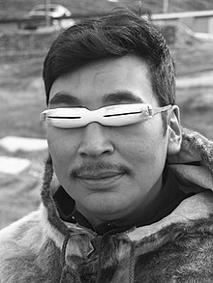
6. Other Types of Blindness
  a. Snow blindness is a painful condition of temporary partial or complete blindness caused by overexposure to the glare of sunlight, such as on snow fields at high altitudes.
    i. Treatment includes resting the eyes in a dark room for several days to allow the inflammation to decrease.
    ii. The Inuit traditionally wore goggles with thin slits to help prevent snow blindness

Slide 11
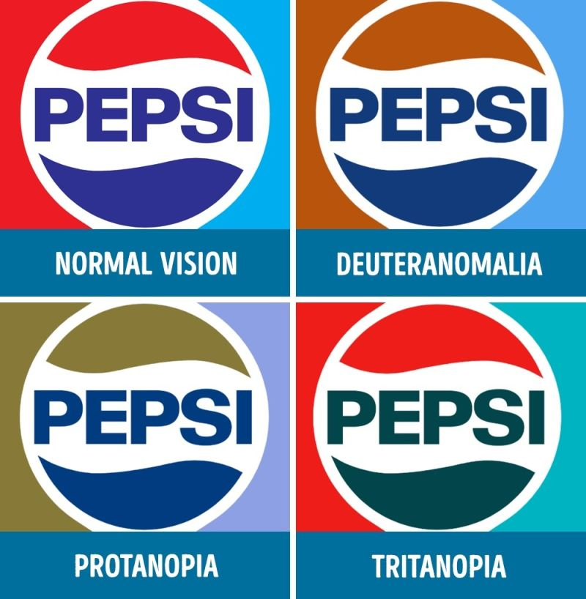
  b. Night blindness is a condition in which it is difficult or impossible to see in dim light.
    i. A common cause is the rod cells losing their ability to respond to light.
  c. Colour blindness is the ability to see only in shades of grey, and occurs in about one person in every 40 000.
  d. Colour vision deficiency is an inability to distinguish certain colours
    i. Colour vision deficiency is quite common, occurring in about 8 percent of males and 1 percent of females.
    ii. There are many kinds of colour vision deficiency because one, two, or all three kinds of cone cells may be involved.
      The most common kind of colour vision deficiency involves the inability to tell red and green apart.
      For those affected, both colours appear to be shades of yellow.

