Slide 1
Electromagnetic Radiation 7 - Using Lenses to Form Images

Slide 2
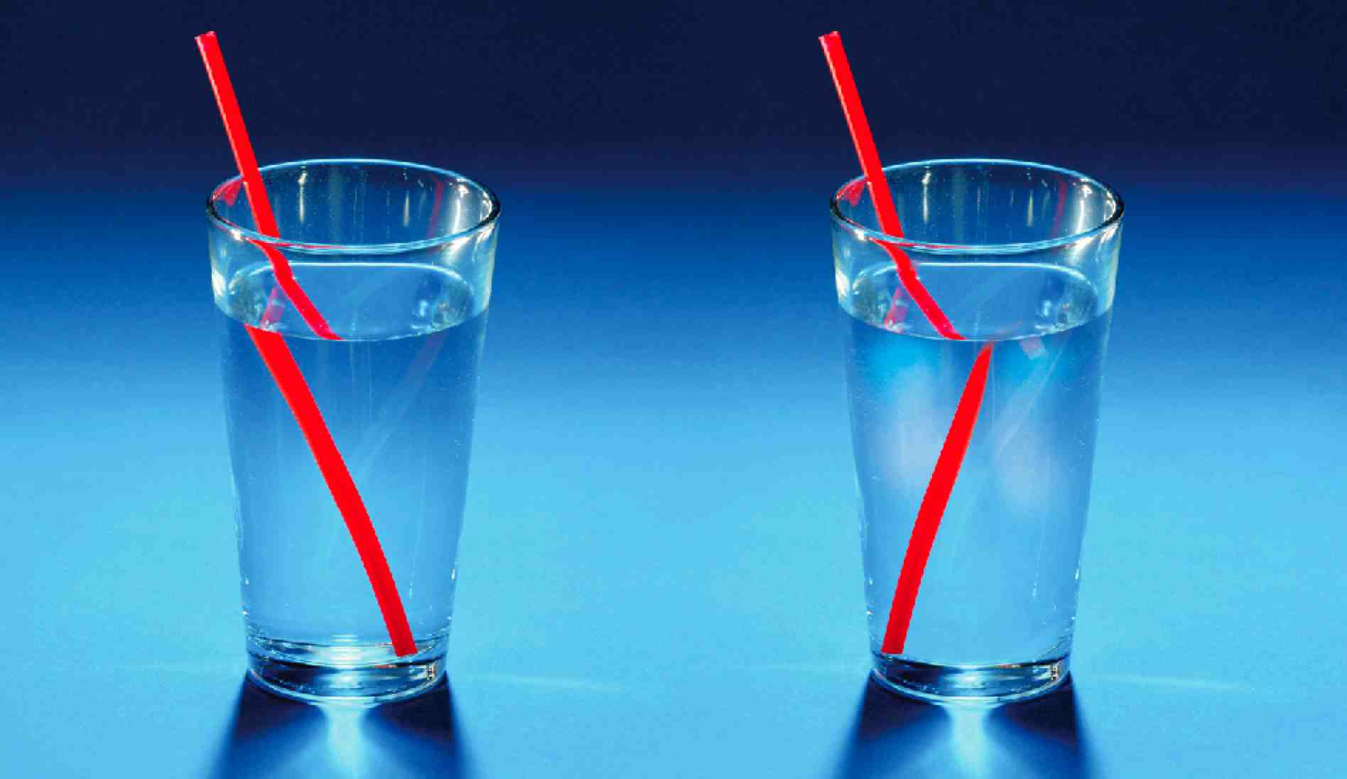
1. Light rays refract through a piece of glass in a predictable way.
a. When a light ray passes from air into a denser material, such as glass, it bends toward the normal.
b. When the light ray passes out of the glass, back into the air, it bends away from the normal.

Slide 3
2. It is possible to design a way to bend light in a certain way
a. A lens is a curved piece of transparent material, (usually glass or plastic), that refracts light in such a way to converge or diverge parallel light rays.
b. The image that a lens forms depends on the shape of the lens.
c. A lens can be convex or concave.

Slide 4
3. Concave lenses are lenses that are thinner in the middle than at the edge.
a. Light rays that pass through a concave lens diverge.
i. The rays are refracted outward, and never meet at a focal point.

Slide 5
b. The image formed is always upright and smaller than the actual object
c. Concave lenses are used in some types of eyeglasses and some telescopes, and are often used in combination with other lenses.

Slide 6
4. Convex lenses are lenses that are thicker in the middle than at the edge.
a. Light rays that pass through a convex lens come together, or converge.
i. When parallel rays strike a convex lens from one side, they will all come together at the focal point of the lens.

Slide 7
b. Light passing through the thicker, more curved areas of the lens will bend more than light passing through the flatter areas.
i. A light ray that passes straight through the centre of the lens is not refracted.
c. The image formed by a convex lens depends on the positions of the lens and the object
i. Convex lenses and concave mirrors share a similar property in that the light rays converge at the focal point.
ii. The distance from the centre of the lens or mirror to the focal point is called the focal
ii. There is a mathematical relationship linking the distance of the object in front of the lens to the distance of the image formed by the lens.

Slide 8
d. If the object is more than two focal lengths in front of the lens, the image is smaller than the object and inverted.

Slide 9
e. If the object is moved closer to the lens so that it is one to two focal lengths away, the image is larger than the object and still inverted.

Slide 10
f. If the object is very close, less than one focal length away, the image appears to be located on the other side of the lens and is both upright and larger than the object.

