Slide 1
Electromagnetic Radiation 6 - Using Mirrors to Form Images

Slide 2
1. Plane (flat) mirrors
a. E.g. Light from a lamp shines on a blueberry.
i. This light reflects off all points on the blueberry, in all directions.
Only the rays coming from one point are shown.

Slide 3
b. All of the rays from the blueberry that strike the mirror reflect according to the law of reflection.
i. The rays that reach your eye appear to be coming from a point behind the mirror.
The same process occurs for every point on the blueberry.
c. Your brain “knows” that light travels in straight lines.
i. Your brain interprets the pattern of light that reaches your eye as an image of a blueberry behind the mirror.

Slide 4
2. Image size and distance
a. Rays are shown coming from three different points on the bird.
b. These rays reflect off the mirror and back to the bird’s eye.
i. Notice that the points appear to be coming from behind the mirror.
ii. Each point appears to be coming from a point that is as far behind the mirror as the real point is in front of the mirror.
iii. Also notice that the three points are exactly the same distance apart in the image as they are on the object, the bird.
iv. These observations explain why an image in a plane mirror is the same size as the object and appears to be the same distance from the mirror as the object.

Slide 5
c. A plane mirror produces an image with the same orientation as the object.
i. If you are standing on your feet, a plane mirror produces an image of you standing on your feet.
ii. The ray that diverges from the right hand of the boy converges at what appears to be the left hand of his image.
iii. Left and right appear to be reversed by a plane mirror.

Slide 6
3. A concave mirror is a mirror that curves inward.
a. Concave mirrors reflect light rays to form images.
b. Parallel light rays bounce off the curved surface of a concave mirror and then meet at a single point called the focal point.
i. Light rays are converging (coming together) at the focal point.

Slide 7
c. The image formed by a concave mirror depends on how far the object is from the focal point of the mirror
i. If a distant object is reflected in a concave mirror, its image is small and upside down
ii. As the object approaches the focal point, its image remains inverted but gets ever larger.
iii. If the object is between the focal point and the mirror, then the image appears to be larger than the object and is upright.

Slide 8
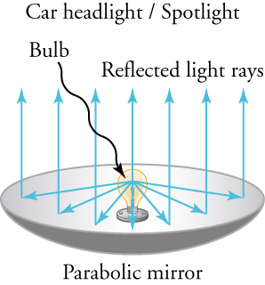
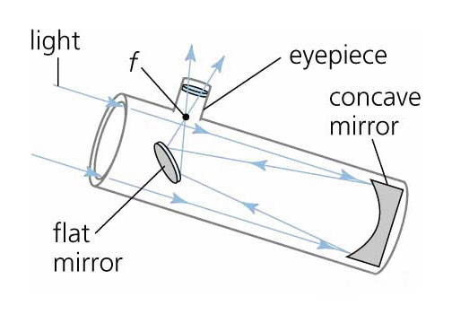
d. Concave mirrors have many uses
i. If a bright light is placed at the focal point, then all the light rays bounce off the mirror and are reflected parallel to each other.
This makes an intense, focussed beam of light.
Spotlights, flashlights, lighthouses, and car headlights use this kind of mirror.
ii. The largest telescopes all use concave mirrors to collect light because the mirror concentrates the light so effectively.

Slide 9
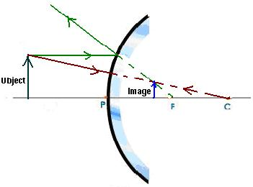
4. A convex mirror is a mirror that curves outwards.
a. Convex mirrors also reflect light rays to form an image, but in an opposite way to concave mirrors.
i. A convex mirror reflects parallel light rays as if they came from a focal point behind the mirror
ii. Light rays that spread apart after reflecting are described as diverging.
iii. The image formed is always upright and smaller than the actual object.
iv. More objects can be seen in a convex mirror than in a plane mirror of the same size.

Slide 10
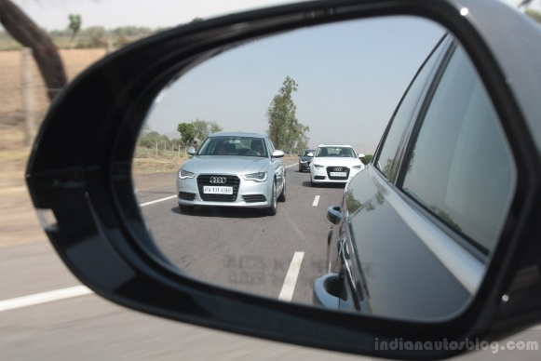
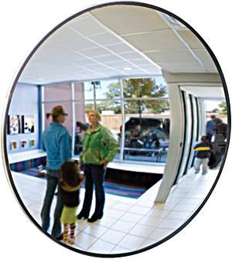
b. Security mirrors, such as those in convenience stores, are large convex mirrors.
i. Convex mirrors make it possible to monitor a large region of the store from a single location
ii. Convex mirrors can also widen the view of traffic that can be seen in rearview or side-view mirrors of automobiles.
Distances and sizes seen in a convex mirror are not realistic
Most convex side-view mirrors carry a printed warning that the objects viewed are closer than they appear to be

