Slide 1
Electromagnetic Radiation 5 - Reflection and Refraction

Slide 2
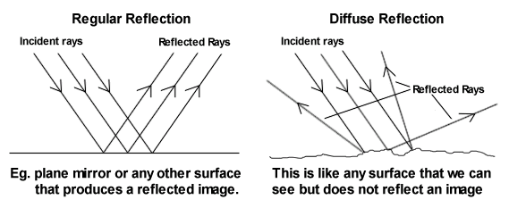
1. To act as a mirror, a surface needs to be smooth compared to the wavelength of the light striking the surface
a. Even though a surface may feel smooth, microscopically the surface is uneven and rough
b. Light rays bounce off randomly at all angles, giving the surface the appearance of being translucent
c. Since the light is reflecting off the surface art many different angles, we can see the object from many different angles
i. This is known as diffuse reflection

Slide 3
The Law of Reflection

Slide 4
The Law of Reflection

Slide 5
The Law of Reflection

Slide 6
The Law of Reflection

Slide 7
The Law of Reflection

Slide 8
The Law of Reflection

Slide 9
The Law of Reflection

Slide 10
a. The incoming ray is called the incident ray.
b. The ray that bounces off the mirror is called the reflected ray.
c. A dotted line has been drawn at right angles to the mirror called the normal.
i. The normal is an imaginary line that is perpendicular to the boundary between two materials
ii. The angle formed by the incident beam and the normal is the angle of incidence, labelled i.
iii. The angle formed by the reflected beam and the normal is the angle of reflection, labelled r.
d. The angle is always measured from the normal line to the ray, not from the mirror to the ray.
e. Observations for all types of surfaces have shown that the angle of reflection is the same as the angle of incidence.
i. Therefore, this observation is considered to be a law.

Slide 11
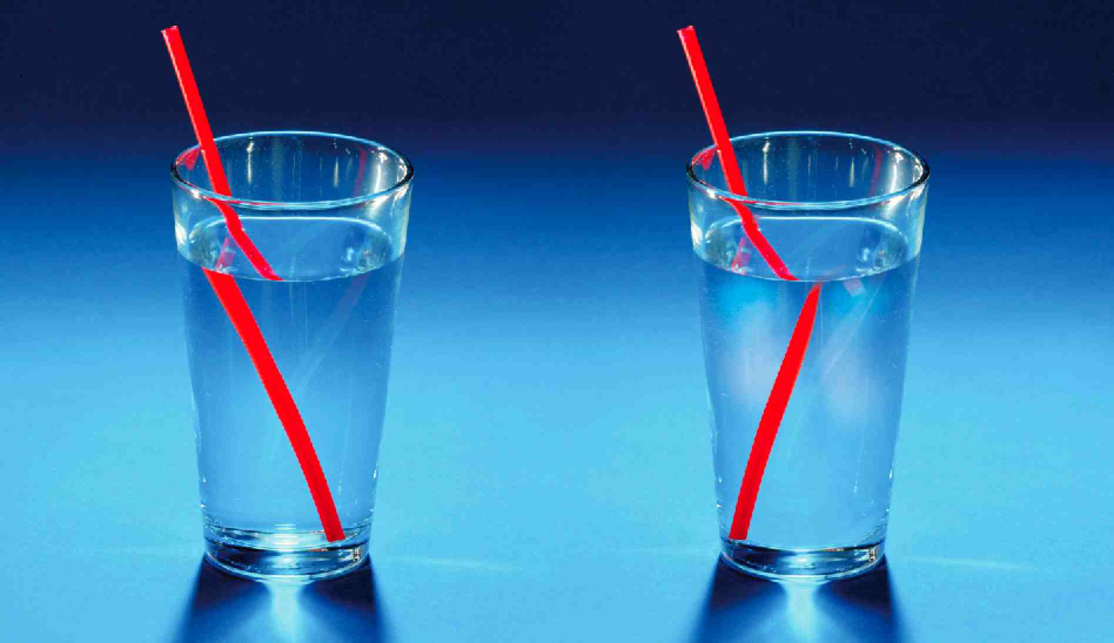
3. Light can be bent, or refracted, if it changes speed as it travels from one medium into another.
a. When light rays move from air into glass, they slow down and change direction because the glass is denser than air.
i. Once inside the glass, the light rays move in a straight line.
ii. But if the light rays leave the glass and move back into the air, where they can travel faster, they will change direction again.
b. The angle of refraction (R) is the angle of a ray of light emerging from the boundary between two materials, such as from air into glass, measured between the refracted ray and the normal.

Slide 12
c. When a light ray passes into a medium in which it slows down, the light ray is refracted toward the normal.
d. When a light ray passes into a medium in which it speeds up the light ray is refracted away from the normal.

Slide 13
4. Refraction of Light in Water
a. The light rays reflected from the fish are refracted away from the normal as they pass from water to air and enter your eyes.
b. The brain assumes that all light rays have travelled in a straight line.
i. The light rays that enter your eyes seem to have come from a fish that was higher in the water.

Slide 14
5. Refraction of Light in Air
a. Refraction can also occur when light travels through air at different temperatures.
i. Warm air is less dense than cold air.
b. Light bends as it travels through different densities of air.
i. The refraction of light through air can result in a mirage, which is a misleading appearance or illusion.

Slide 15
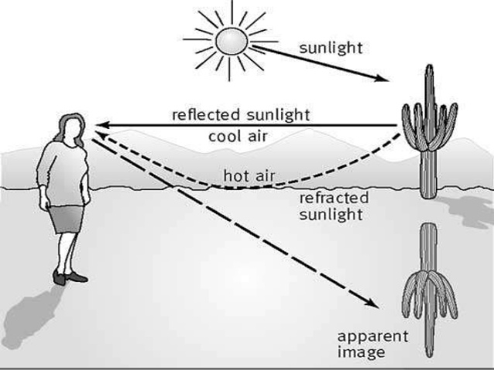
c. E.g. the “water mirage” on a hot day
i. The air closer to the ground is hotter and less dense than air higher up.
ii. Light from the sky directed at the ground is bent upward as it enters the less dense air.
iii. The “pools of water” are actually images of the sky refracted by warm air near the ground
iv. Our brain associates light reflecting off a surface as water

