Slide 1
Electromagnetic Radiation 4 – Optics and the Ray Model of Light

Slide 2
1. Sir Isaac Newton was able to separate the colours from white light using a prism
a. This is evidence that light can viewed as a wave
i. The use of wavelength and frequency help to account for the different colours of light
b. However, Newton believed that light is a stream of fast-moving, unimaginably tiny particles.
i. E.g. a lantern flame releases tiny particles of light, which travel in a perfectly straight line
ii. This model came to be called the particle model of light
The particle model of light was later proven by Albert Einstein
The particle so light are called photons
c. Today we view light as both a wave and a particle

Slide 3
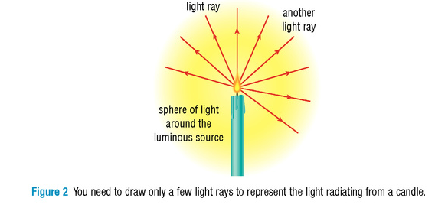
2. Optics is a branch of physics that studies electromagnetic radiation (E.g. light and infrared radiation), and its interactions with matter
a. E.g. looking at the behaviour of light when it reflects off mirrors or passes through lenses
i. The type of matter in an object determines the amount of light it absorbs, reflects, and transmits.
b. It is very helpful to use a simplified model called the ray model of light.
i. In the ray model, light is simply represented as a straight line, or ray, that shows the direction the light wave is travelling

Slide 4
3. Transparent
a. Some materials will transmit light, which means that light can get through them without being completely absorbed.
i. When light passes through clear materials, the rays continue along their path.
b. A transparent material allows light to pass through it freely.
i. Only a small amount of light is absorbed and reflected.
ii. Objects can be clearly seen through transparent materials
c. Air, water, and window glass are all examples of transparent materials

Slide 5
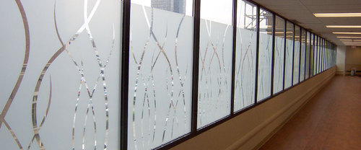
4. Translucent
a. In a translucent material, such as frosted glass or a lampshade, most light rays get through, but are scattered in all directions.
b. Translucent materials do not allow objects to be seen distinctly.
c. Translucent glass is often used in windows to let in light without losing privacy.

Slide 6
5. Opaque
a. An opaque material prevents any light from passing through it.
b. An opaque material absorbs and reflects light—no light passes through it.

Slide 7
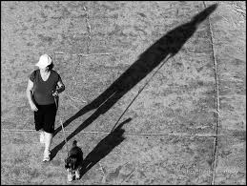
6. Shadows
a. The ray model can be used to predict where shadows will form and how large they will be.
b. E.g. when you are walking away from the Sun during sunset your shadow becomes much longer than you are tall
i. Your body casts a shadow because it blocks the light rays striking you.
ii. Since the light is striking at an angle the light rays are spreading out further
This makes the shadow longer
iii. The light rays on either side of you continue in a straight line until they hit the ground

Slide 8
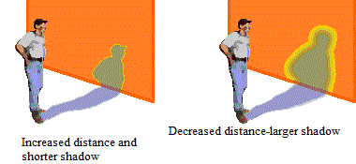
c. The closer you are to a light source, the larger the shadow will be
i. The light rays that pass by are able to spread out further
ii. The edges of the shadow will be less defined

