Slide 1
Electromagnetic Radiation 3 – The Wave Properties of Light

Slide 2
1. Light is can be modelled as wave since light exhibits certain behaviors that are characteristic of any wave
a. Light reflects and refracts in the same manner that any wave would refract.
i. Reflection involves a change in direction of waves when they bounce off a barrier.
ii. Refraction of waves involves a change in the direction of waves as they pass from one medium to another.
b. There are three other behaviors that light can exhibit
i. Light diffracts
ii. Light undergoes interference
iii. Light exhibits the Doppler effect

Slide 3
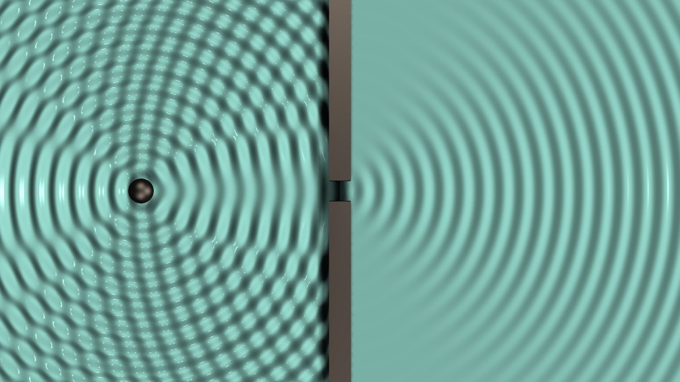
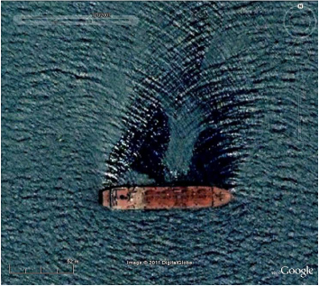
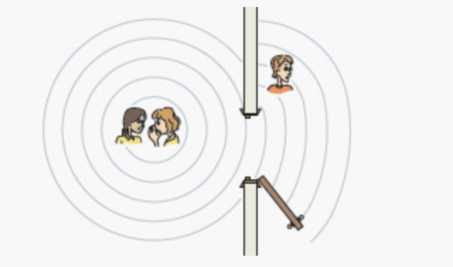
2. Diffraction involves a change in direction of waves as they pass through an opening or around an obstacle in their path.
a. Water waves have the ability to travel around corners, around obstacles and through openings.
i. Sound waves do the same.

Slide 4
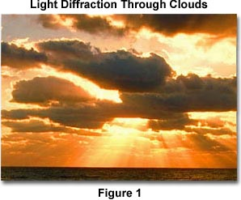
b. When light encounters an obstacle in its path, the obstacle blocks the light and tends to cause the formation of a shadow in the region behind the obstacle.
i. Light does not exhibit a very noticeable ability to bend around the obstacle and fill in the region behind it with light.
ii. Light does diffract around obstacles.
If you observe a shadow carefully, you will notice that its edges are extremely fuzzy.

Slide 5
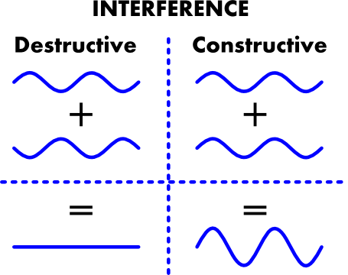
3. Wave interference is the phenomenon that occurs when two waves meet while traveling along the same medium.
a. Constructive interference is a type of interference that occurs at any location along the medium where the two interfering waves have a displacement in the same direction.
i. The result is that the two pulses add onto each other when they are completely overlapped

Slide 6
b. Destructive interference is a type of interference that occurs at any location along the medium where the two interfering waves have a displacement in the opposite direction
i. The result is that the two pulses completely destroy each other when they are completely overlapped.

Slide 7
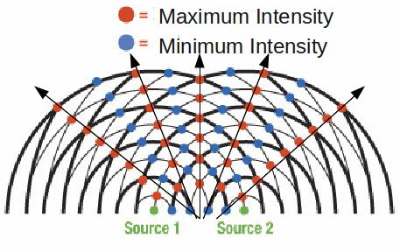
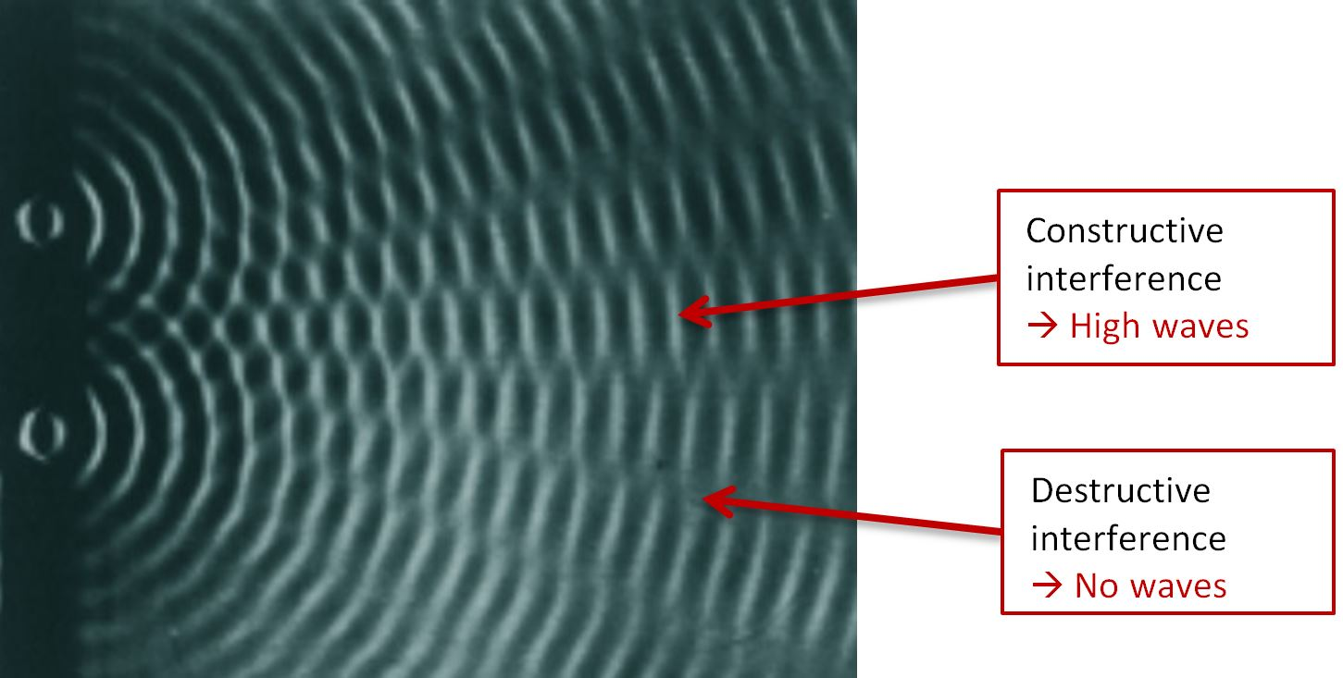
c. The interference of waves led to a very important experiment
i. If the waves from two sources of waves meet they will undergo interference

Slide 8
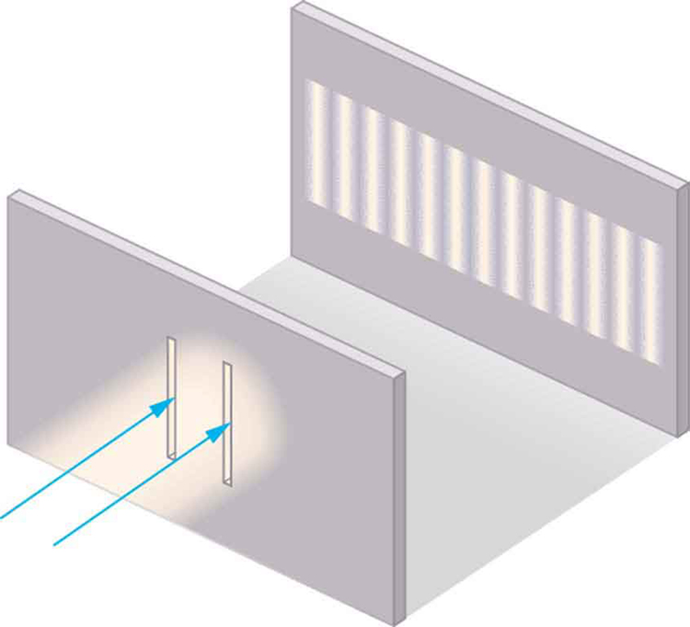
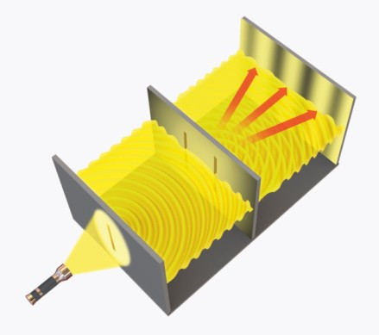
ii. In 1801, Thomas Young devised a way to show that light waves could show a similar pattern of interference
Light was passed through two small slits to create two sources of light
The two sources of light created a pattern consistent with the interference pattern

Slide 9
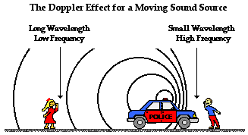
4. The Doppler effect is observed whenever the source of waves is moving with respect to an observer.
a. It is the effect produced by a moving source of waves in which there is an apparent
i. Upward shift in frequency for observers towards whom the source is approaching
ii. Downward shift in frequency for observers from whom the source is moving away.

Slide 10
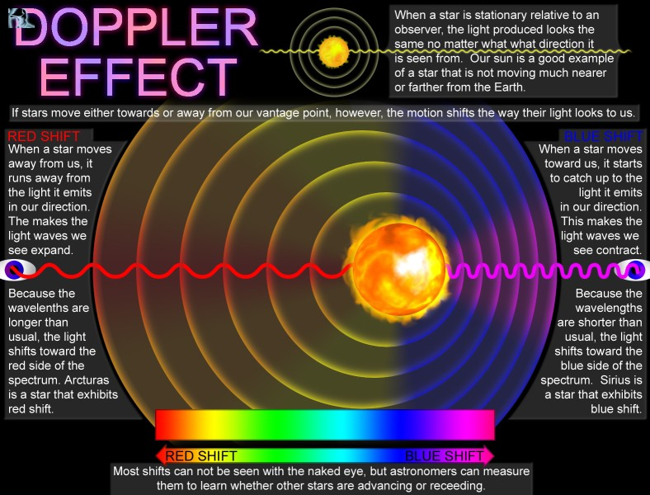
b. The belief that the universe is expanding is based in part upon observations of electromagnetic waves emitted by stars in distant galaxies
i. The light from galaxies tends to shift to the red end of the spectrum
ii. The light waves from galaxies are being stretched as the galaxies move away

