Slide 1
12.2 Features of Plate Tectonics (Part 2)

Slide 2
1. Types of plate interactions
a plate boundary is a region where two tectonic plates are in contact
There are three main types of plate interaction: divergence (spreading apart), convergence (moving together), and transform (sliding by).
i. The way in which tectonic plates interact depends on two main factors:
the type of plate
the direction the plates are moving relative to one another

Slide 3
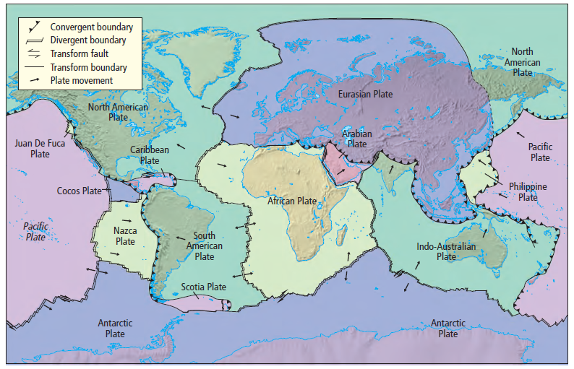

Slide 4
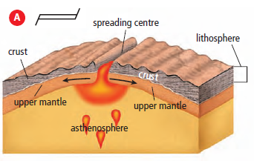
2. Divergent plate boundaries
a. These are areas where tectonic plates are spreading apart
i. Plates that are spreading apart are known as diverging plates.
b. The Mid- Atlantic Ridge is a system of spreading ridges separating the Americas from Africa, Europe, and Asia.
i. It is the largest mountain range on Earth, with the greatest amount of volcanic activity.
c. diverging plates at the East African Rift are slowly breaking Africa into pieces.

Slide 5
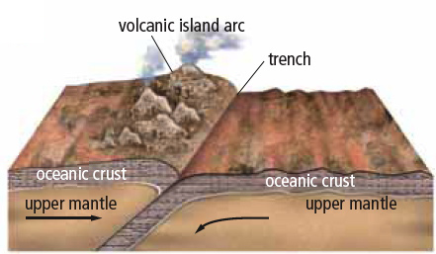
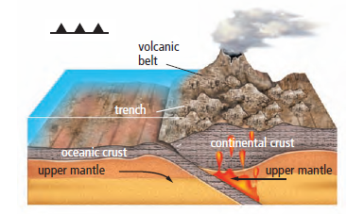
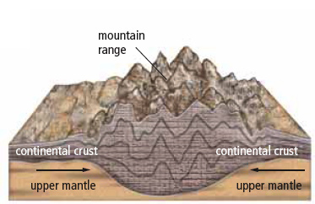
3. Convergent plate boundaries
a. This occurs where tectonic plates collide.
i. Plates that collide are known as converging plates.
ii. depending on the nature of the converging plates results vary

Slide 6
b. Oceanic-continental plate convergence
i. the dense oceanic plate is forced to slide beneath the less dense continental plate.
A deep underwater valley, called a trench, forms where the tectonic plates make contact
As the subducting plate moves deeper, large pieces melt off.
Much of this melted material cools and crystallizes into large rock masses below the surface of the continental plate.
ii. If conditions are right, magma can work its way to the surface, forming cone-shaped volcanoes.
E.g. in the Cascadia subduction zone the Juan deFuca Plate (an oceanic plate) subducts below the North American Plate (a continental plate).
This resulted in the volcanoes of the west coast

Slide 7
iii. The force of the collision between oceanic and continental plates creates mountain ranges as the continental rock crumples and folds.
E.g. British Columbia’s Coast Mountains and Cascade Mountain Range.
iv. Sometimes colliding plates resist the force of convection currents, ridge push, and slab pull.
Pressure builds as long as the plates remain stuck in place.
When the released stress and energy result in an earthquake.

Slide 8
c. Oceanic-oceanic plate convergence
i. Subduction also occurs where two oceanic plates converge
ii. Cooling will cause one plate to be denser than the other, and the denser plate will slide deep into the mantle.
The convergence may produce a long chain of volcanic islands known as a volcanic island arc
The islands of Japan and Indonesia and the Aleutian Islands of Alaska are examples of volcanic island arcs.
these regions can experience earthquakes of various magnitudes.

Slide 9
d. Continental-continental plate convergence
i. subduction does not occur due to the plates’ similar densities
ii. instead their edges fold and crumple, forming great mountain ranges.
the Himalayas, formed as a result of the Indian continent colliding with the Asian continent,
The Himalayas continue to increase in elevation by several centimetres per year due to the movement of the Indian tectonic plate northward.

Slide 10
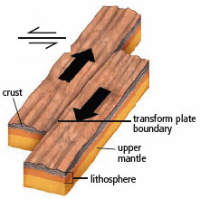
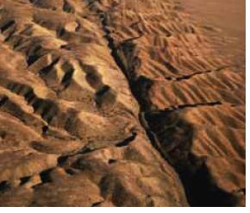
4. Transform plate boundaries
a. Convection currents in the mantle often cause tectonic plates to slide past each other.
i. This mostly occurs near ocean ridges and is known as a transform plate boundaries
b. since rock slides past rock, no mountains or volcanoes form but earthquakes and faults may result.
i. A fault breaks in rock layers due to movement on either side
a transform fault occurs a transform plate
ii. E.g. the San Andreas Fault in California is due to the oceanic Pacific Plate sliding past the continental North American Plate.

