Slide 1
12.2 Features of Plate Tectonics

Slide 2
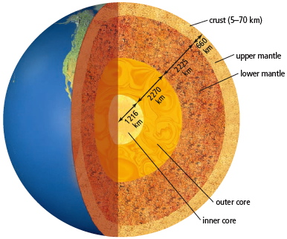
1. The Earth is over 6400 km thick
a. It is believed to be composed of 4 distinct layers

Slide 3
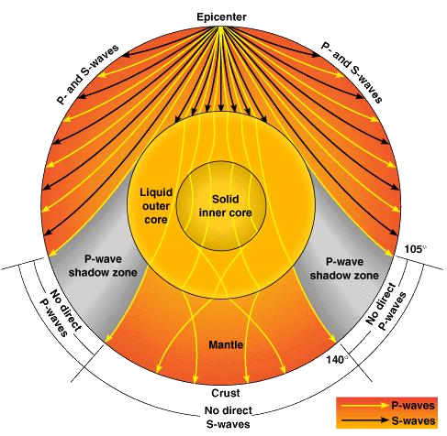

Slide 4
2. The crust is the Earth’s outermost layer.
a. There are two main types
i. Continental crust is made from a lighter type of rock called granite
ii. Oceanic crust is made from a dense, dark rock called basalt
b. Earth’s outer crust is made of several large, rigid but mobile chunks of rock known as tectonic plates.
i. tectonic plates form the lithosphere is made up of the crust and the uppermost mantle
ii. There are about 12 major tectonic plates and many smaller ones.

Slide 5
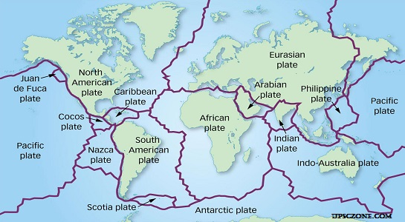

Slide 6
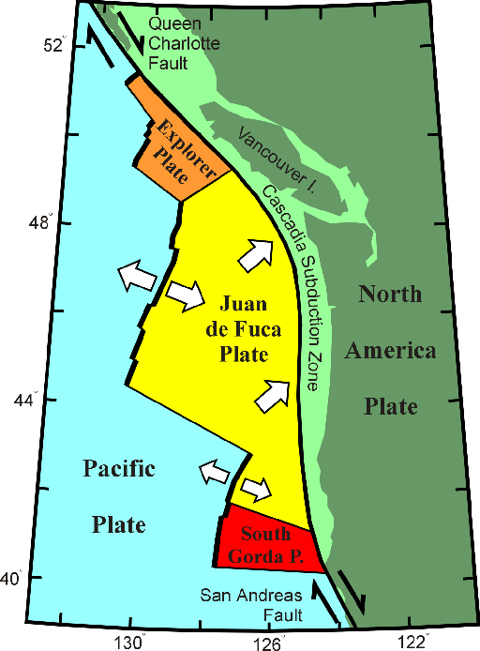

Slide 7
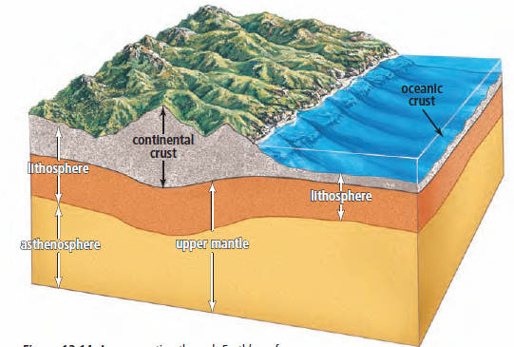
3. The mantle is Earth’s thickest layer and makes up 70 percent of Earth’s volume
a. It is mostly solid and can be divided into two sections
i. The upper mantle is composed of partly molten rock (magma) that flows like thick toothpaste
ii. The lower mantle is made of solid, dense material

Slide 8
b. the asthenosphere refers to the partly molten layer in the upper mantle.
i. The temperature of the asthenosphere can vary
ii. this may be due to large quantities of radioactive elements such as uranium whose decay heats up the mantle in certain spots.

Slide 9
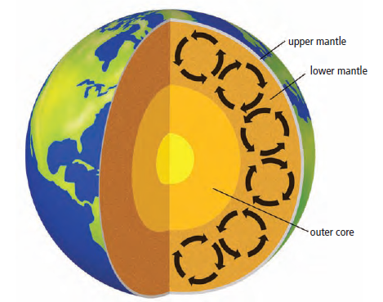
c. Convection currents in the mantle result when the hotter, less dense, material in the mantle rises, cools, then sinks again, only to be reheated
i. mantle convection is believed to be one of the driving forces behind plate movement
ii. Currents in the asthenosphere move the tectonic plates above, and the continents move with them.

Slide 10
4. The layer below the mantle is the outer core
a. the outer core is liquid and is composed mainly of a mixture of iron and nickel.
b. The inner core is at Earth’s centre.
i. It is a sphere 2400 km in diameter, composed mainly of iron and some nickel.
ii. temperatures at the core range from 5000ºC to 6000ºC, but the high pressures at the core keep the iron solid.
c. Scientists believe that the inner and outer cores rotate at different speeds and may be responsible for Earth’s magnetic field.

Slide 11
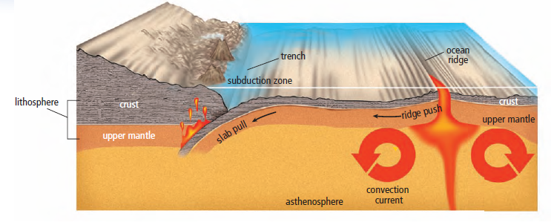
5. Push and pull of magma
a. Rising currents of magma eventually reach Earth’s surface at spreading centres.
i. a spreading centre in the ocean is called a spreading ridge, or oceanic ridge
ii. a spreading centre on land is less common, and is called a rift valley.
b. Magma cools as it reaches the surface and becomes “new” rock.
i. The new material at a ridge or rift pushes older material aside, and the tectonic plates move away from the ridge.
This process is called a ridge push

Slide 12
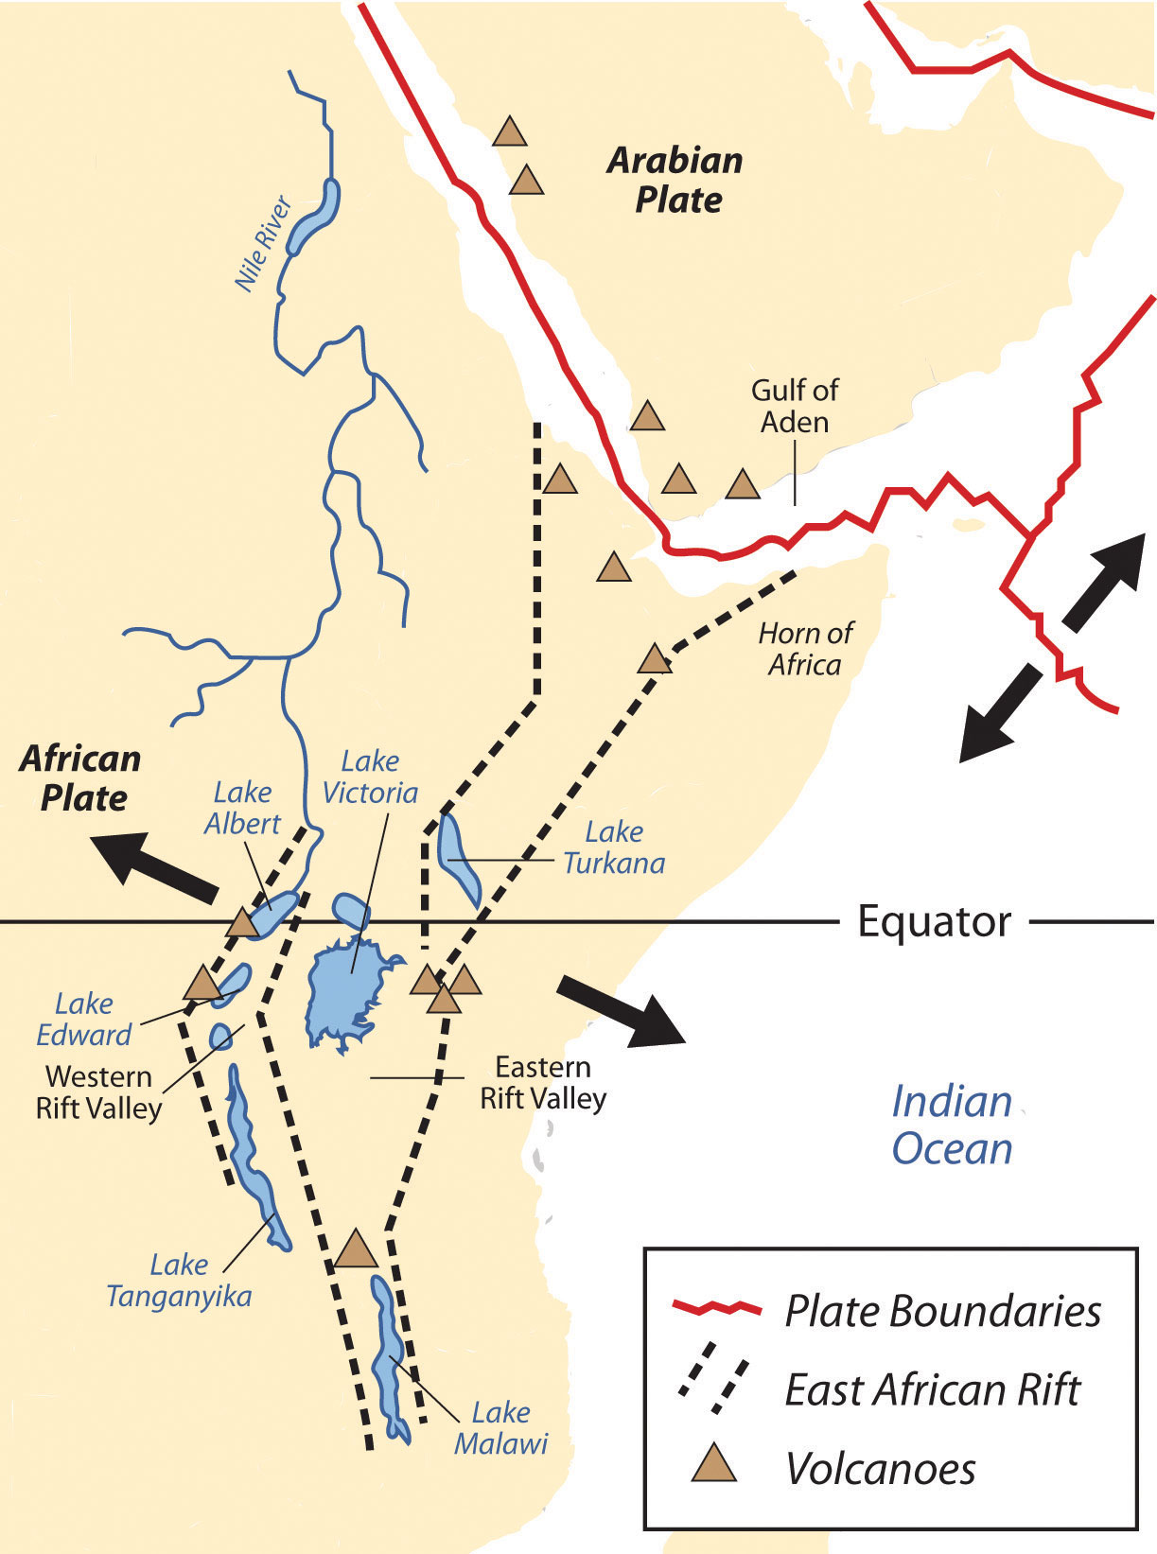
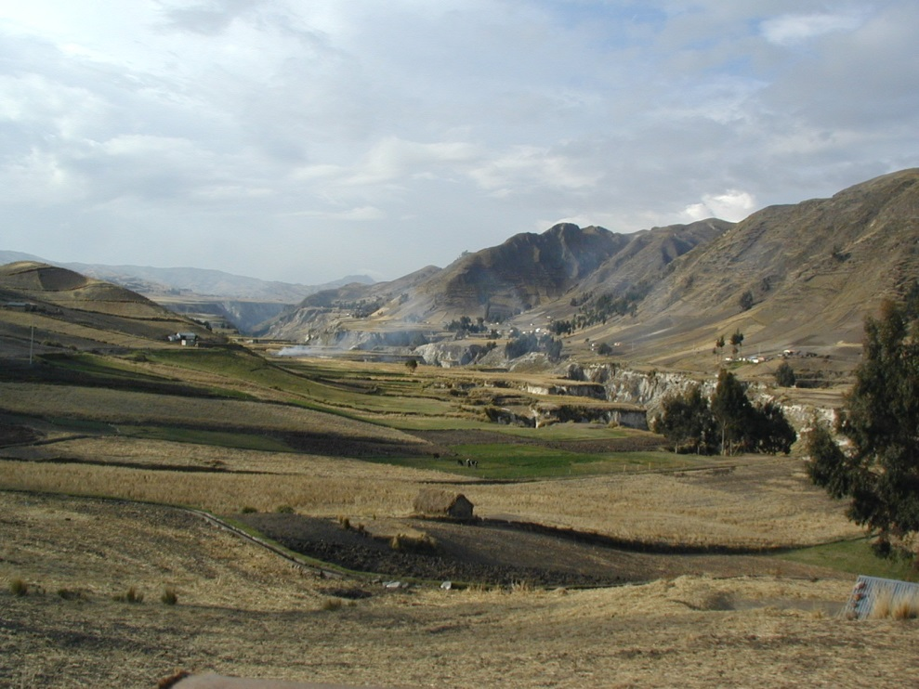
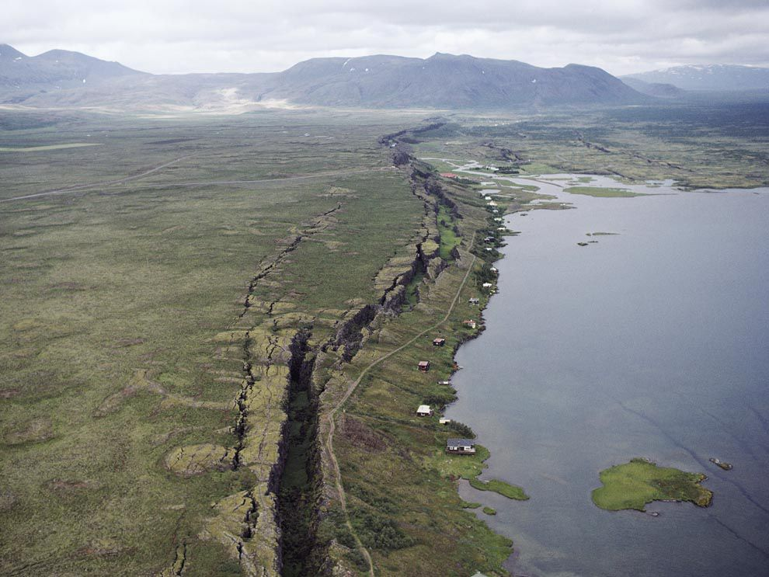

Slide 13
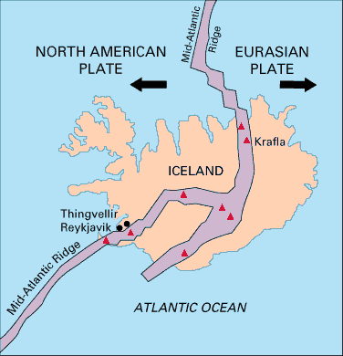
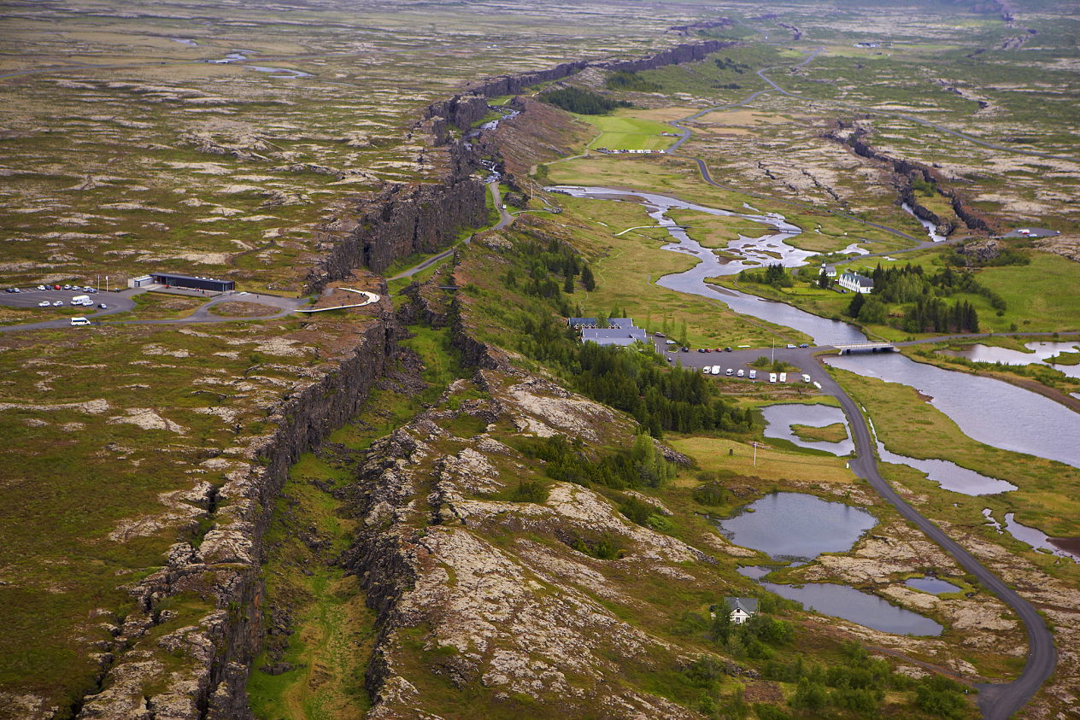

Slide 14
c. Eventually one plate will bump into another plate.
i. If a dense oceanic plate collides with a continental plate, the heavy oceanic plate will dive deep under the lighter continental plate
This is known as Subduction
ii. subduction zones, typically experience large earthquakes and volcanic eruptions.
iii. as the edge of a tectonic plate subducts deep into the mantle, it pulls the rest of the plate with it.
This process is called slab pull.
d. convection currents, ridge push, slab pull helps keep tectonic plates in motion.

Slide 15
